Slide 1
Relative Valuation
Second Valuation Method
Kalaitzoglou Iordanis

Slide 2
Future Plan
Discounted Cash Flows
Relative Valuation
Real Options
Define a multiple
Describe Multiple
Analyse Multiple
Apply Multiple
Earnings Multiple
Book Value Multiples
Revenues Multiple
This Session

Slide 3
What is relative valuation?
In relative valuation, the value of an asset is compared to the values assessed by the market for similar or comparable assets.
To do relative valuation then,
we need to identify comparable assets and obtain market values for these assets
convert these market values into standardized values, since the absolute prices cannot be compared This process of standardizing creates price multiples.
compare the standardized value or multiple for the asset being analyzed to the standardized values for comparable asset, controlling for any differences between the firms that might affect the multiple, to judge whether the asset is under or over valued
Notes:
These are the three ingredients you find in almost every equity research report - comparables, a multiple (or standardized price) and a story (which represents the attempt to control for differences).

Slide 4
Standardizing Value
Prices can be standardized using a common variable such as earnings, cashflows, book value or revenues.
Earnings Multiples
Price/Earnings Ratio (PE)
and variants (PEG and Relative PE)
Value/EBIT
Value/EBITDA
Value/Cash Flow
Book Value Multiples
Price/Book Value(of Equity) (PBV)
Value/ Book Value of Assets
Value/Replacement Cost (Tobin’s Q)
Revenues
Price/Sales per Share (PS)
Value/Sales
Industry Specific
Price/kwh,
Price per ton of steel ....
Notes:
The distinction between price (representing equity value) and value (representing the combined market value of equity and debt) and enterprise value (representing firm value - cash and marketable securities) should be noted.
The last set of multiples - industry specific multiples - will vary depending upon the sector you look at. With power companies, it can take the form of market value of the firm/ kwh of power produced. With new economy companies in the late 1990s, this was taken to whole new levels of detail - value per subscriber, value per web site visitor….

Slide 5
Four Steps to Understanding Multiples
Define
Same multiples can be defined in different ways. When using multiples, estimated by others, we need to know how the multiples have been estimated
Describe
We need to know what the cross sectional distribution of the multiple is. If we do not, it is difficult to decide whether it is too high or low.
Analyze
It is critical that we understand the fundamentals that drive each multiple, and the nature of the relationship between the multiple and each variable.
Apply
Defining the comparable universe and controlling for differences is far more difficult in practice than it is in theory.
Consistency
Uniformly Estimated
Mean
Outliers
Time Variance
Standard Deviation
Fundamentals
Changes in Fundamentals
Comparable Firms based on Fundamentals
Impossible to find identical firm, Control for differences
Notes:
While we can rail about the fact that a valuation based upon multiples is not as detailed as a discounted cashflow valuation,, the reality is that analysts will continue to use multiples to value companies and that we will often have to use these valuations.
Given this reality, we have to think about how best to use multiples. These four steps represent a way in which we can deconstruct any multiple, understand how to use it well and discover when it is being misused.
Definitional Tests
Is the multiple consistently defined?
Proposition 1: Both the value (the numerator) and the standardizing variable ( the denominator) should be to the same claimholders in the firm. In other words, the value of equity should be divided by equity earnings or equity book value, and firm value should be divided by firm earnings or book value.
Is the multiple uniformly estimated?
The variables used in defining the multiple should be estimated uniformly across assets in the “comparable firm” list.
If earnings-based multiples are used, the accounting rules to measure earnings should be applied consistently across assets. The same rule applies with book-value based multiples.
Consistent definition:
Consider two widely used multiples that are consistently defined. In the price-earnings ratio (PE), the numerator is equity value per share and the denominator is equity earnings per share. In the enterprise value/ EBITDA multiple, the numerator is firm value and the denominator is a pre-tax cash flow to all claimholders in the firm. In contrast, the price to EBITDA multiple is inconsistent. Why is this a problem? If you are comparing firms with different debt ratios, the firms with more debt will look cheaper on a price to EBITDA basis.
Uniformally Estimated:
This is actually much more difficult than it looks. Even if accounting standards are the same across firms, you run into two problems:
The degree to which firms bend accounting rules for their own purposes varies across firms. Some firms are inherently more conservative in reporting earnings than others.
The financial year ends at different points for different firms. If the denominator is the earnings in the most recent financial year, the multiple may not be comparable if some firms have December year-ends and some have June year-ends.
Descriptive Tests
What is the average and standard deviation for this multiple, across the universe (market)?
What is the median for this multiple?
The median for this multiple is often a more reliable comparison point.
How large are the outliers to the distribution, and how do we deal with the outliers?
Throwing out the outliers may seem like an obvious solution, but if the outliers all lie on one side of the distribution (they usually are large positive numbers), this can lead to a biased estimate.
Are there cases where the multiple cannot be estimated? Will ignoring these cases lead to a biased estimate of the multiple?
How has this multiple changed over time?
Before you use a multiple and develop rules of thumb (8 times EBITDA is cheap), you need to get a sense of the cross-sectional distribution.
Multiples have skewed distributions. Because a multiple cannot be less than zero but can potentially be infinite, the averages for multiples will be much higher than their medians, and the difference will increase as the outliers become larger. Many services cap outliers to prevent them from altering the averages too much, results…
The PE ratio cannot be estimated when the earnings per share are negative. Thus, if you have a sample of 20 firms and 10 have negative earnings, you will be able to compute the PE ratio for only the 10 that have positive earnings and will throw out the remaining firms. This will induce a bias in your sample. One way to avoid this is to take the cumulative values for market capitalization and net income for all 20 firms, and compute a PE ratio based upon the cumulated values. The resulting PE ratio will generally be much higher….
Analytical Tests
What are the fundamentals that determine and drive these multiples?
Proposition 2: Embedded in every multiple are all of the variables that drive every discounted cash flow valuation - growth, risk and cash flow patterns.
In fact, using a simple discounted cash flow model and basic algebra should yield the fundamentals that drive a multiple
How do changes in these fundamentals change the multiple?
The relationship between a fundamental (like growth) and a multiple (such as PE) is seldom linear. For example, if firm A has twice the growth rate of firm B, it will generally not trade at twice its PE ratio
Proposition 3: It is impossible to properly compare firms on a multiple, if we do not know the nature of the relationship between fundamentals and the multiple.
Behind every multiple (PE of 22, Value to EBITDA of 9) are implicit assumptions about growth, risk and cash flows.. In fact, you make the same assumptions when you use multiples that you make in discounted cashflow valuation.. The difference is that your assumptions are explicit in the latter. The first step in understanding a multiple is determining its fundamental drives…
Not only is it important that you find the drivers for each multiple, but you need to understand how changes in these drivers change the multiple. For example, we all accept the intuition that a company with a 20% growth rate should have a higher PE than an otherwise similar company with a 10% growth rate, but how much higher? Twice as high (which would make the relationship linear), 2.5 times as high, 1.5 times as high…
Application Tests
Given the firm that we are valuing, what is a “comparable” firm?
While traditional analysis is built on the premise that firms in the same sector are comparable firms, valuation theory would suggest that a comparable firm is one which is similar to the one being analyzed in terms of fundamentals.
Proposition 4: There is no reason why a firm cannot be compared with another firm in a very different business, if the two firms have the same risk, growth and cash flow characteristics.
Given the comparable firms, how do we adjust for differences across firms on the fundamentals?
Proposition 5: It is impossible to find an exactly identical firm to the one you are valuing.
In practice, we all too often define comparable as a firm in the same industry or business. This is too narrow a definition. You can have firms in different businesses that have similar cashflow, growth and risk characteristics. These firms can be viewed as comparable firms.
You will never find two identical firms, no matter how hard you search. You therefore have to always control for the residual differences when making comparisons.

Slide 6
Earnings Multiples
Price/Earnings Ratio (PE)
and variants (PEG and Relative PE)
Value/EBIT
Value/EBITDA
Value/Cash Flow
Book Value Multiples
Price/Book Value(of Equity) (PBV)
Value/ Book Value of Assets
Value/Replacement Cost (Tobin’s Q)
Revenues
Price/Sales per Share (PS)
Value/Sales
Notes:
The distinction between price (representing equity value) and value (representing the combined market value of equity and debt) and enterprise value (representing firm value - cash and marketable securities) should be noted.
The last set of multiples - industry specific multiples - will vary depending upon the sector you look at. With power companies, it can take the form of market value of the firm/ kwh of power produced. With new economy companies in the late 1990s, this was taken to whole new levels of detail - value per subscriber, value per web site visitor….

Slide 7
Price Earnings Ratio: Definition
PE = Market Price per Share / Earnings per Share
There are a number of variants on the basic PE ratio in use. They are based upon how the price and the earnings are defined.
Price: is usually the current price
is sometimes the average price for the year
EPS: earnings per share in most recent financial year
earnings per share in trailing 12 months (Trailing PE)
forecasted earnings per share next year (Forward PE)
forecasted earnings per share in future year
Notes:
This is only the tip of the iceberg. You can have EPS before and after extraordinary items, primary and diluted EPS..
When you are negotiating with someone else and you are both using PE ratios to make your case, the first step is to make sure that you are using the same PE ratio.
There is also the tendency on the part of analysts to pick the definition of pE that best fits their biases. For instance, bullish analysts in the 1990s almost always used forward PE whereas bearish analysts used trailing PE. Since earnings were rising the former were generally much lower than the latter.

Slide 8
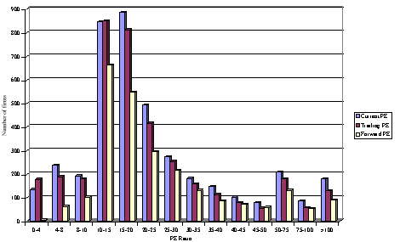
PE Ratio: Descriptive Statistics for the US
Notes:
This graph for all U.S. firms with data available on the Value Line CD ROM (contains about 7200 firms in the overall sample). Notice that the distributions are skewed to the left and that we have capped the PE ratios at 100….

Slide 9
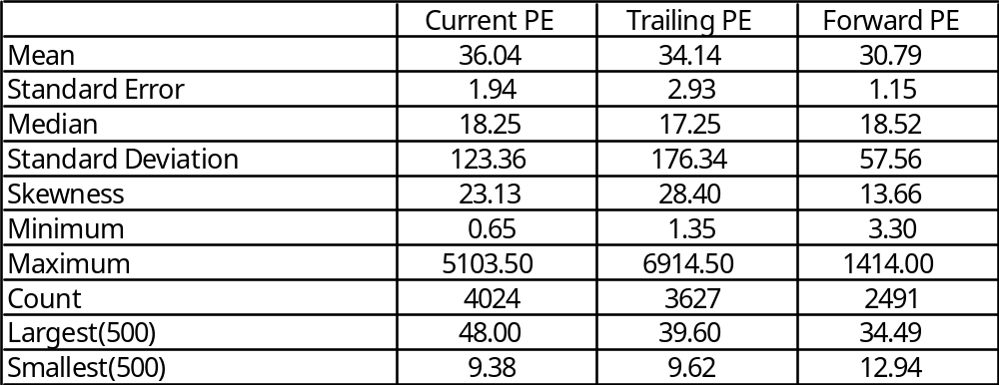
PE: Deciphering the Distribution
Notes:
Four things to note…
Notice the number of firms that we have lost in the sample as we compute PE ratios.
You lose even more firms as you go to forward PE, because you need analyst estimates of expected earnings per share to compute this. Any firms not followed by analysts will not have a forward PE…
The means were computed without capping the PE ratios… the outliers (notice the maximum values for the ratios) push the average to almost twice the median.
The median forward PE is higher than the trailing PE which is higher than the current PE…

Slide 10
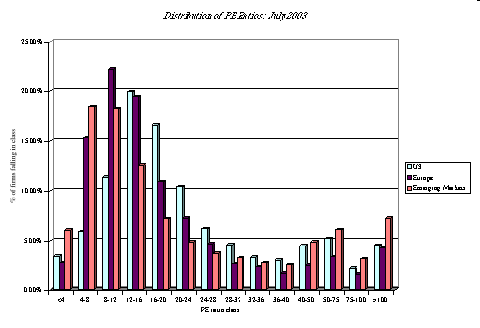
Comparing PE Ratios: US, Europe and Emerging Markets
Median PE
US = 18.25
Europe = 15.09
Em Mkts = 14.32
Notes:
This compares the percentages of firms in each market that trade in each PE ratio class… Some interesting differences:
More emerging market companies trade at very low PE ratios (less than 8) than European or US companies
More emerging market companies also trade at very high multiples of earnings.
The median PE ratio is lowest in emerging markets, reflecting the effect of country risk on PE.

Slide 11
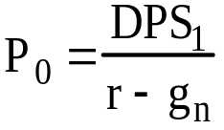
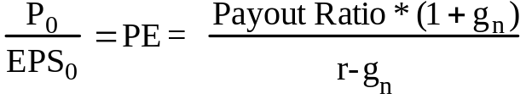
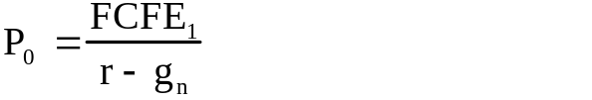
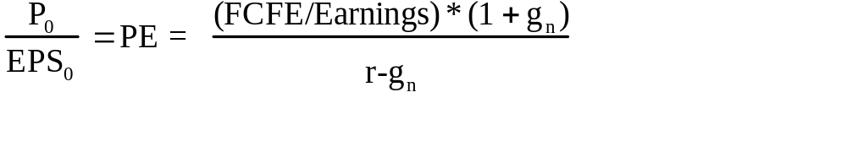
PE Ratio: Understanding the Fundamentals
To understand the fundamentals, start with a basic equity discounted cash flow model.
With the dividend discount model,
Dividing both sides by the earnings per share,
If this had been a FCFE Model,
Notes:
PE Ratio and Fundamentals
Proposition: Other things held equal, higher growth firms will have higher PE ratios than lower growth firms.
Proposition: Other things held equal, higher risk firms will have lower PE ratios than lower risk firms
Proposition: Other things held equal, firms with lower reinvestment needs will have higher PE ratios than firms with higher reinvestment rates.
Of course, other things are difficult to hold equal since high growth firms, tend to have risk and high reinvestment needs.
At first sight, the second proposition may seem counter intuitive. After all, riskiest firms often have the highest PE ratios. The answer lies, of course, in the reality that firms with high risk also tend to have high growth, and growth usually trumps risk….
To get to the heart of equity multiples, we start with an equity DCF model. In this case, we consider the simplest equity valuation model - a stable growth dividend discount model. Restated in terms of the PE ratio, we find that the PE ratio fo a stable growth firm can be written in terms of three variables:
The expected growth rate in earnings per share
The riskiness of the equity, which determines the cost of equity
The efficiency with which the firm generates growth,which is measured by how much the firm can pay out or afford to pay out after reinvested to create the growth.

Slide 12
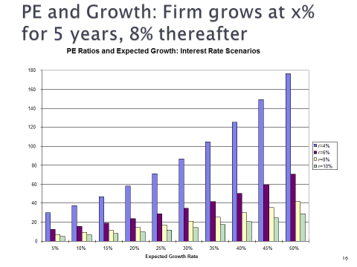
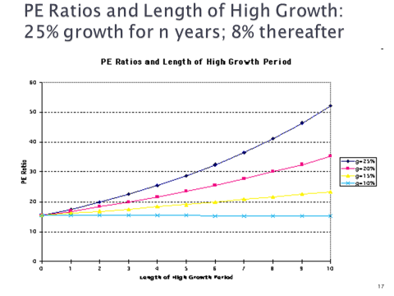
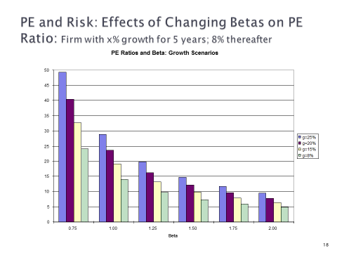
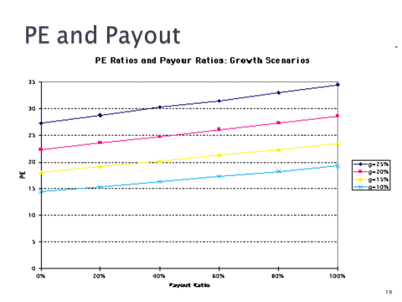
Notes:
PE and Growth
As expected growth in the high growth period increases, the PE ratio increases, but the change in PE ratio for a given change in the growth rate is much greater when interest rates are low than when they are high. The reason is simple. The value of growth is a present value… If interest rates rise, the present value of growth decreases.
If you consider that expected growth rates in earnings usually change as a result of an earnings surprise, this would suggest that a stock’s price and PE ratio will be most sensitive to earnings surprises when interest rates are low than when they are high.
PE and Length of Growth
As you lengthen the growth period, the PE ratio increases but it increases more when the expected growth rate during the period is a high number than when it is lower… The length of the growth period is a function of competitive advantages. This would indicate that you should be much more informed about a firm’s competitive position and aware of the potential slippage in this position when you are investing in a high growth company than when you are investing in a low growth company.
PE and Risk
As risk increases, PE ratios fall, not matter what the expected growth rate. At very high risk (or perceived risk), the PE ratio becomes relatively insensitive to changes in the growth rate. A manager of a high-growth, high risk firm (say a growth rate of 20% and a beta of 2) will get a much bigger payoff to reducing risk than increasing growth.
PE and Payout
Note that this assumes that growth is held constant. The only way you can increase payout, holding growth constant, is to increase the return on equity:
Growth rate = (1 - Payout ratio) ROE
Thus, this graph could have been drawn in terms of the ROE. Higher return on equity companies will have higher PE ratios than lower ROE companies with the same expected growth rate in earnings. Consider it the payoff to quality growth.

Slide 13
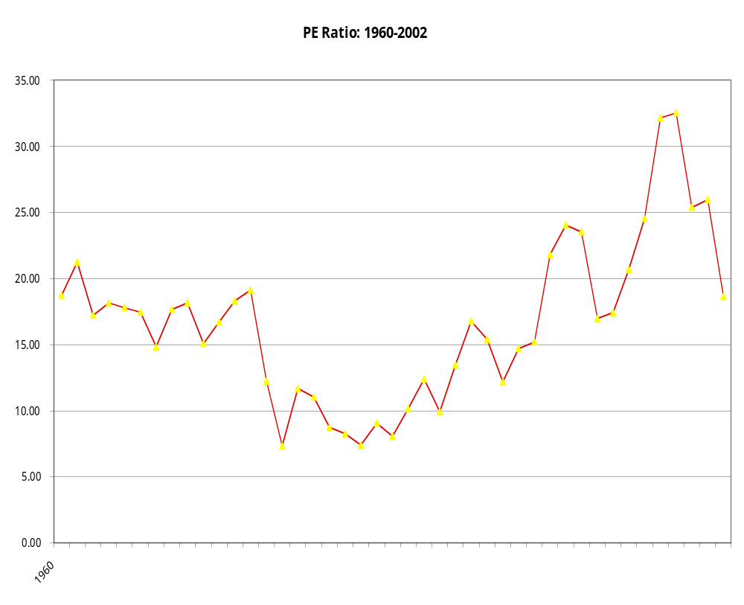
PE across time: S&P 500
Is low (high) PE cheap (expensive)?
Notes:
The graph of PE ratios for the S&P 500 show an increasing PE ratio over time… The PE ratio in 1999 was clearly much higher than PE ratios over the prior two decades…
Is low (high) PE cheap (expensive)?
A market strategist argues that stocks are over priced because the PE ratio today is too high relative to the average PE ratio across time. Do you agree?
Yes
No
If you do not agree, what factors might explain the higher PE ratio today?
Not necessarily. There are other possible explanations, that relate back to the fundamentals that determine PE:
Discount rate: The discount rate applied to earnings and cashflows may be lower - this can occur either because
interest rates were lower in 1999 than they were in the 1980s
Investors may have perceived that equities were less risky and demanded a lower risk premium (there are related stories including the influx of pension fund money into stocks)
b. Expected Growth: By 1999, higher-growth technology firms like Cisco and Microsoft were a much larger segment of the S&P 500. The expected growth rate in earnings for stocks in the index would therefore be higher..
c. More Efficient Growth: U.S. stocks did increase the returns on their investments during the 1990s. This would translate into the capacity to return more cash to stockholders while maintaining growth…

Slide 14
Apply the Multiple
Comparable Firms/Sector: What value does the multiple have in firms that are very similar-Regression-Average
The idea is to find firms that form a group that is very similar to the company we evaluate
Then we can compare the value of the multiple you have found to the ones of the competitors/firms in the group
You can decide whether the value you have found is higher or lower than the average
Equivalent Firms/Market: What is the value of the multiple of an average firm that has similar characteristics-Regression
The firms do NOT need to be identical
They might be comparable in terms of the variables we choose to compare them with
We run a regression and find what value of the multiple, given that other firms that have similar values for the variables we have chosen exhibit this value on their multiples
Notes:
Using comparables Pros and Cons
The most common approach to estimating the PE ratio for a firm is
to choose a group of comparable firms,
to calculate the average PE ratio for this group and
to subjectively adjust this average for differences between the firm being valued and the comparable firms.
Problems with this approach.
The definition of a 'comparable' firm is essentially a subjective one.
The use of other firms in the industry as the control group is often not a solution because firms within the same industry can have very different business mixes and risk and growth profiles.
There is also plenty of potential for bias.
Even when a legitimate group of comparable firms can be constructed, differences will continue to persist in fundamentals between the firm being valued and this group.
Using the entire crosssection: A regression approach
In contrast to the 'comparable firm' approach, the information in the entire cross-section of firms can be used to predict PE ratios.
The simplest way of summarizing this information is with a multiple regression, with the PE ratio as the dependent variable, and proxies for risk, growth and payout forming the independent variables.
Potential Problems
Negative Values
Multicolinearity
There is information in how the market prices all firms that can be used to value any firm in that market.
Negative constant (negative predictions)
Regression without a constant.
Multicolinearity
In a multiple regression, the independent variables should be uncorrelated with each other - the correlations should be zero between growth and beta, growth and payout, payout and beta… As the correlation matrix above indicates, this is not always the case.

Slide 15

Running a regression

Slide 16
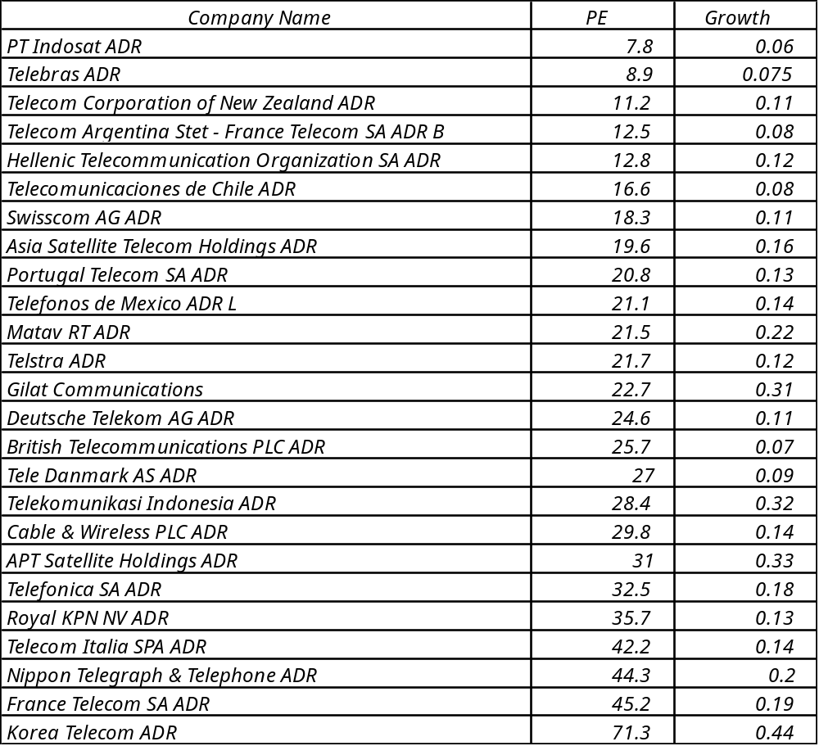
Comparing PE Ratios across a Sector
Notes:
In this sample, note that some of the firms in the sample are emerging market firms any may be exposed to more risk (political risk, economic risk, inflation risk…)

Slide 17
PE, Growth and Risk
Dependent variable is: PE
R squared = 66.2% R squared (adjusted) = 63.1%
Variable Coefficient SE t-ratio prob
Constant 13.1151 3.471 3.78 0.0010
Growth rate 1.21223 19.27 6.29 ≤ 0.0001
Emerging Market -13.8531 3.606 -3.84 0.0009
Emerging Market is a dummy: 1 if emerging market
0 if not
Notes:
Higher growth telecomm companies have higher PE ratios..
One way to read this regression: If you have two companies - one with a growth rate of 10% and one with a growth rate of 20%, the latter should have a PE that is 12.1 higher..
If the firm happens to be an emerging market firm, though, you would expect its PE ratio to be 13.85 lower than a firm with similar growth in a developed market.

Slide 18
Is Telebras under valued?
Predicted PE = 13.12 + 1.2122 (7.5) - 13.85 (1)
= 8.35
At an actual price to earnings ratio of 8.9, Telebras is slightly overvalued.
Notes:
With a 7.5% growth rate and being an emerging market company, Telebras is overvalued slightly, even though it has a low PE ratio.

Slide 19
Earnings Multiples
Price/Earnings Ratio (PE)
and variants (PEG and Relative PE)
Value/EBIT
Value/EBITDA
Value/Cash Flow
Book Value Multiples
Price/Book Value(of Equity) (PBV)
Value/ Book Value of Assets
Value/Replacement Cost (Tobin’s Q)
Revenues
Price/Sales per Share (PS)
Value/Sales

Slide 20
Value/Earnings and Value/Cashflow Ratios
While Price earnings ratios look at the market value of equity relative to earnings to equity investors, Value earnings ratios look at the market value of the firm relative to operating earnings. Value to cash flow ratios modify the earnings number to make it a cash flow number.
The form of value to cash flow ratios that has the closest parallels in DCF valuation is the value to Free Cash Flow to the Firm, which is defined as:
Value/FCFF = (Market Value of Equity + Market Value of Debt-Cash)
EBIT (1-t) - (Cap Ex - Deprecn) - Chg in WC
Consistency Tests:
  If the numerator is net of cash (or if net debt is used, then the interest income from the cash should not be in denominator
  The interest expenses added back to get to EBIT should correspond to the debt in the numerator. If only long term debt is considered, only long term interest should be added back.
Notes:
In contrast to price multiples, you look at firm or enterprise value when you compute value multiples. Firm value is the market value of equity + market value of debt. Enterprise value = Firm value - cash. Why would you use one as opposed to the other? When we compute value to earnings multiples, the earnings that are used tend to be operating earnings (EBIT, EBITDA etc.). Since the income from cash and marketable securities is not included in operating income, we exclude it from the numerator as well.
The most logical denominator for enterprise value is the free cashflow to the firm, which is the cashflow prior to debt payments but after taxes and reinvestment needs.

Slide 21
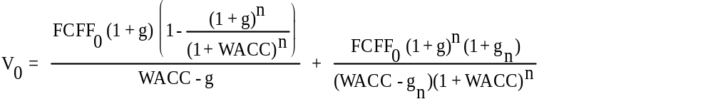
Value of Firm/FCFF: Determinants
Reverting back to a two-stage FCFF DCF model, we get:
  V₀ = Value of the firm (today)
  FCFF₀ = Free Cashflow to the firm in current year
  g = Expected growth rate in FCFF in extraordinary growth period (first n years)
  WACC = Weighted average cost of capital
  g_{n} = Expected growth rate in FCFF in stable growth period (after n years)
Notes:
To investigate the determinants of the value to FCFF, we go back to a firm valuation model (rather than an equity valuation model).
This is a two-stage FCFF model - the first term in the equation is the present value of FCFF during the high growth phase and the second term is the present value of the terminal value…

Slide 22
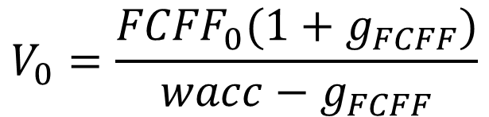
Value Multiples
Value of the firm today (if you divide by FCFF, you get the Vf/FCFF)
The value/FCFF multiples is a function of
  the cost of capital
  the expected growth
$$V_{0}=\frac{{FCFF}_{0}(1+g_{FCFF})}{wacc−g_{FCFF}}$$
Notes:
Dividing both sides by the FCFF, we obtain the determinants of the free cashflow to the firm. In summary, the value to FCFF multiple is determined by the cost of capital and expected growth in FCFF.

Slide 23
Alternatives to FCFF - EBIT and EBITDA
Most analysts find FCFF too complex or messy to use in multiples (partly because capital expenditures and working capital have to be estimated). They use modified versions of the multiple with the following alternative denominator:
  after-tax operating income or EBIT(1-t)
  pre-tax operating income or EBIT
  net operating income (NOI), a slightly modified version of operating income, where any non-operating expenses and income is removed from the EBIT
  EBITDA, which is earnings before interest, taxes, depreciation and amortization.
Notes:
Analysts prefer short cuts, because they do not require as many estimates. To estimate FCFF, you have to estimate net capital expenditures and working capital changes.. Using EBIT, EBIT (1-t) or EBITDA allows you to get by without these estimates.
Reasons for Increased Use of Value/EBITDA
1. The multiple can be computed even for firms that are reporting net losses, since earnings before interest, taxes and depreciation are usually positive.
2. For firms in certain industries, such as cellular, which require a substantial investment in infrastructure and long gestation periods, this multiple seems to be more appropriate than the price/earnings ratio.
3. In leveraged buyouts, where the key factor is cash generated by the firm prior to all discretionary expenditures, the EBITDA is the measure of cash flows from operations that can be used to support debt payment at least in the short term.
4. By looking at cashflows prior to capital expenditures, it may provide a better estimate of “optimal value”, especially if the capital expenditures are unwise or earn substandard returns.
5. By looking at the value of the firm and cashflows to the firm it allows for comparisons across firms with different financial leverage.
The use of EBITDA multiples is relatively new in acquisitions. It acquired a foothold in the mid-1980s with leveraged buyouts but has acquired a large number of adherents since. The growth of cable, cellular and telecommunications companies may explain some of this…

Slide 24
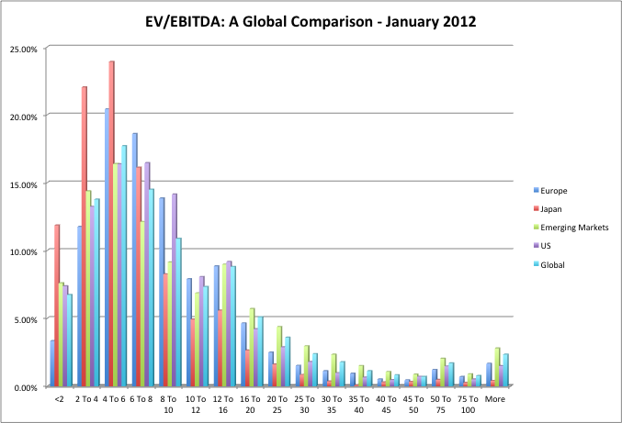
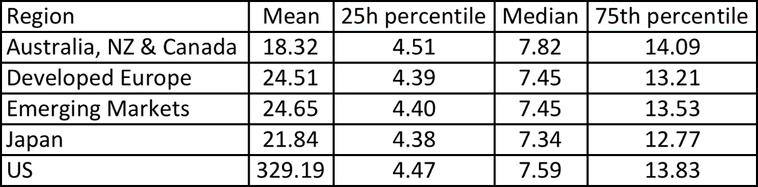
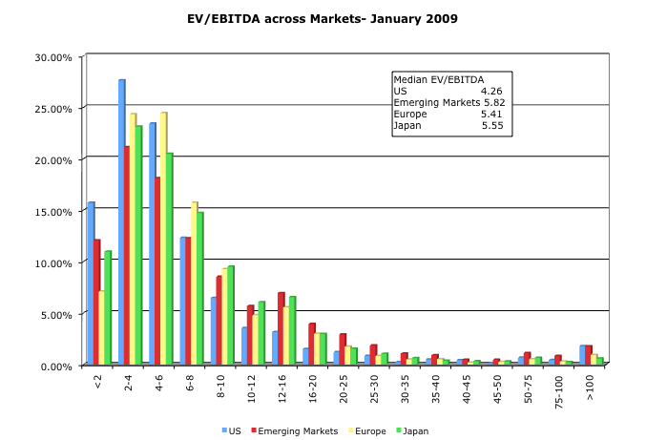
Enterprise Value/EBITDA : Global Data
6 times EBITDA may seem like a good rule of thumb..
But not in early 2009…
24
Notes:
Rules of thumb have to adapt to data… Fixed rules of thumb work sometimes and not at others…

Slide 25
Earnings Multiples
Price/Earnings Ratio (PE)
and variants (PEG and Relative PE)
Value/EBIT
Value/EBITDA
Value/Cash Flow
Book Value Multiples
Price/Book Value(of Equity) (PBV)
Value/ Book Value of Assets
Value/Replacement Cost (Tobin’s Q)
Revenues
Price/Sales per Share (PS)
Value/Sales

Slide 26
Price-Book Value Ratio: Definition
The price/book value ratio is the ratio of the market value of equity to the book value of equity, i.e., the measure of shareholders’ equity in the balance sheet.
Price/Book Value = Market Value of Equity
Book Value of Equity
Consistency Tests:
  If the market value of equity refers to the market value of equity of common stock outstanding, the book value of common equity should be used in the denominator.
  If there is more that one class of common stock outstanding, the market values of all classes (even the non-traded classes) needs to be factored in.
Notes:
Your definitions of equity in the numerator and denominator should be consistent… this may require the breaking down of book equity if there are multiple classes of shares outstanding.
If you have a class of shares that is non-traded, you have two choices. You can ignore this in computing market equity and take out a proportional shares of the book equity. Alternatively, you can estimate a value for the non-traded shares and add them to the market value of traded shares to arrive at a total market value of equity. It is generally not a good idea to include preferred stock in either the numerator or denominator.

Slide 27
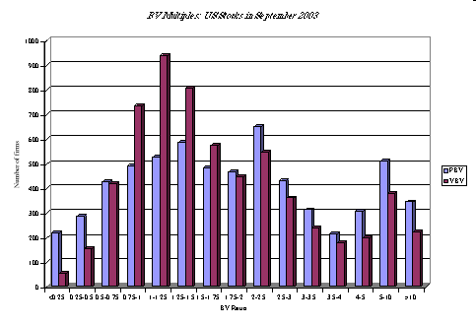
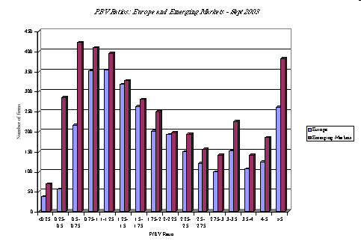
Price to Book Value: US stocks
Price to Book: Europe and Emerging Markets
Notes:
The median is about half the mean… You do lose some firms (those with negative book equity) but not as many as you do with earnings multiples.
Europe-Emerging Markets
A larger portion of stocks trade at below book value in Europe than do in the United States. An even large proportion trade at below book value in emerging markets, but there are also far more outliers with very high PBV ratios.

Slide 28
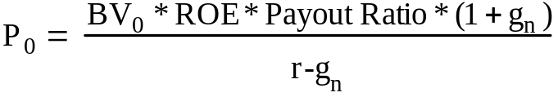
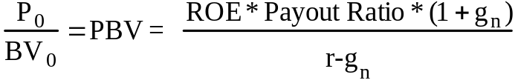
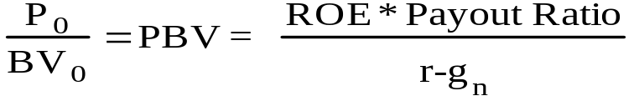
Price Book Value Ratio: Stable Growth Firm
Going back to a simple dividend discount model,
Defining the return on equity (ROE) = EPS₀ / Book Value of Equity, the value of equity can be written as:
If the return on equity is based upon expected earnings in the next time period, this can be simplified to,
Notes:
Following a familiar route.. The price to book ratio is an equity multiple and you go back to an equity valuation model…
The price to book ratio is determined by the three variables that determine the PE ratio (growth, payout and risk) and one variable that is unique to it (the return on equity)
Every multiple has one variable that can be considered its key determinant - its companion variable, so to speak. For PE, it was growth.. For Value/EBITDA, it was the reinvestment rate. For price to book, it is return on equity.

Slide 29
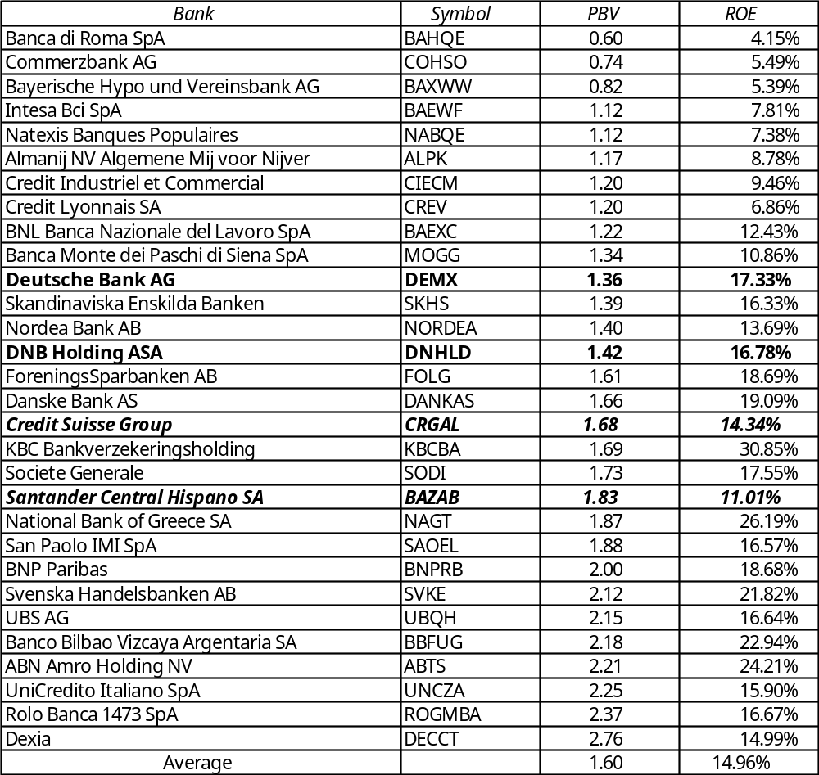
PBV/ROE: European Banks
Regressing
PBV ratios against ROE
PBV = 0.81 + 5.32 (ROE) R² = 46%
  For every 1% increase in ROE, the PBV ratio should increase by 0.0532.

Slide 30
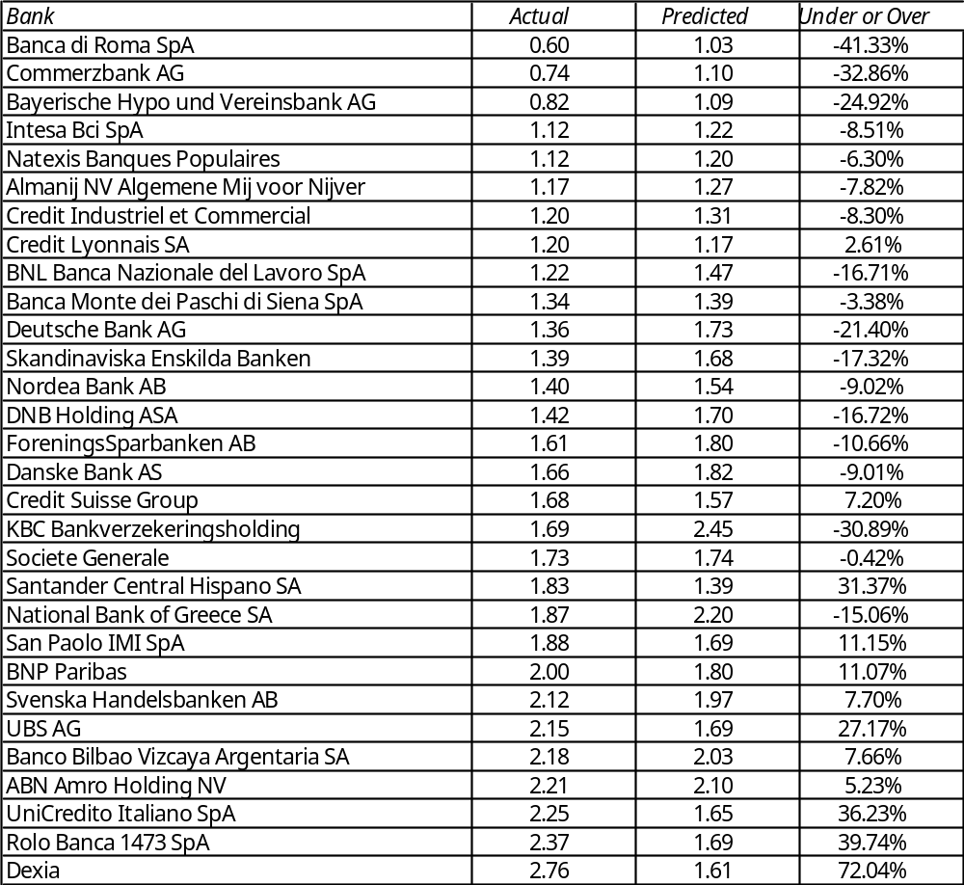
Under and Over Valued Banks?
Notes:
Uses the regression to get predicted values for each bank. You can get a range for each prediction and determine which stocks fall outside the range…

Slide 31
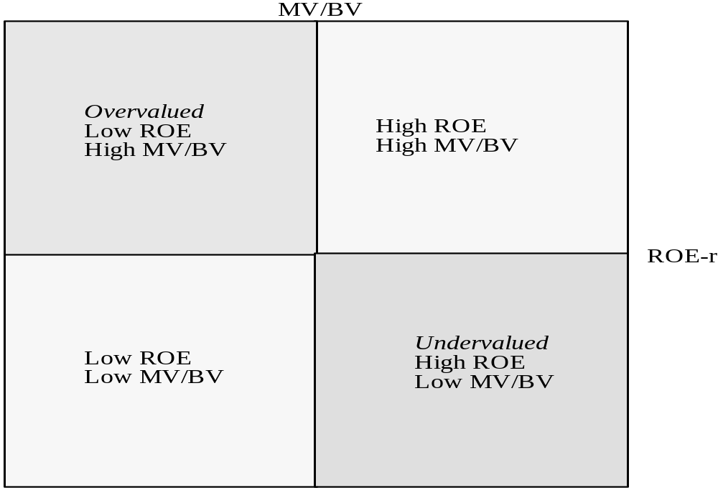
The Valuation Matrix
Notes:
Presents the mismatches in a matrix. You want to buy stocks in lower right quadrant and sell the stocks in the upper left quadrant… A hedge fund?
Looking for undervalued securities - PBV Ratios and ROE
Given the relationship between price-book value ratios and returns on equity, it is not surprising to see firms which have high returns on equity selling for well above book value and firms which have low returns on equity selling at or below book value.
The firms which should draw attention from investors are those which provide mismatches of price-book value ratios and returns on equity - low P/BV ratios and high ROE or high P/BV ratios and low ROE.
Most companies that trade at high price to book or low price to book deserve to trade at those multiples. The mismatches matter…

Slide 32
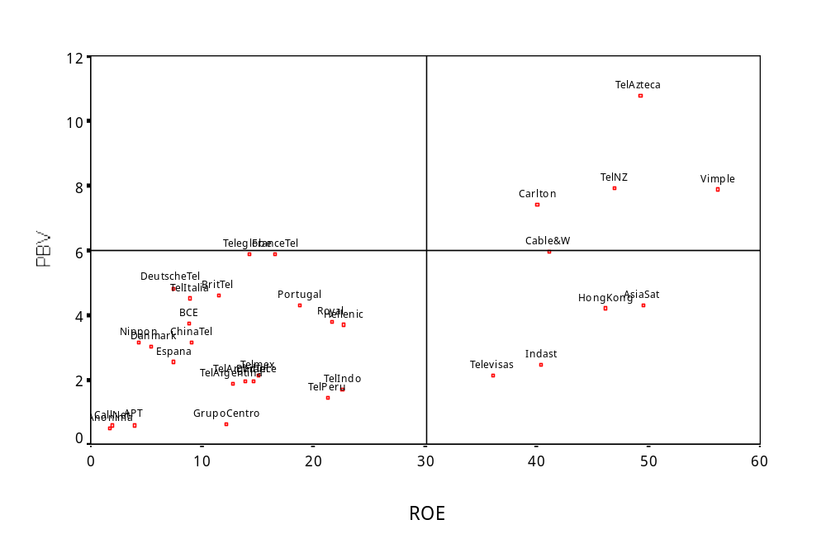
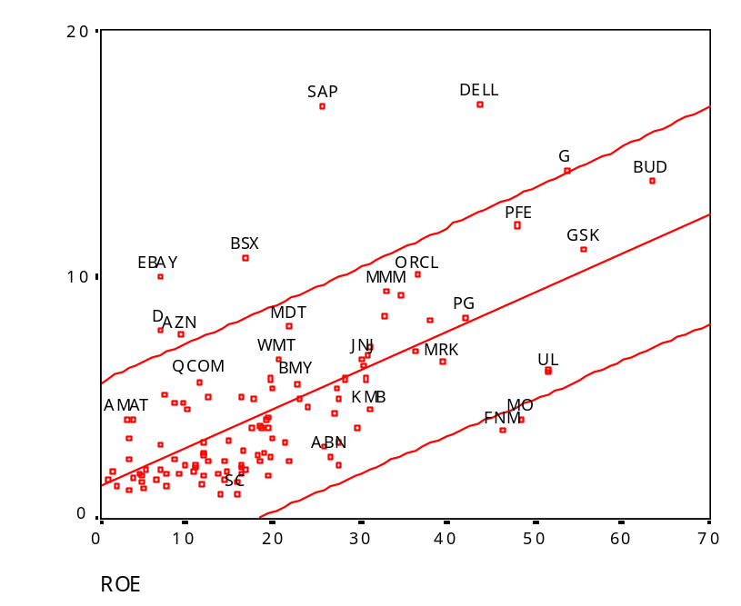
Price to Book vs ROE: Largest Market Cap Firms in the United States
PBV Matrix: Telecom Companies
Notes:
PBV Matrix
The most undervalued firms are all emerging market telecomm firms.. The implicit assumption we make about companies all being equally risk may be inappropriate here.
You could create a three dimensional graph with risk on the third axis. An undervalued firm would then be one with low price to book, high return on equity and low risk.
Regression-Strength of the link
Looks at the 100 largest market cap firms in the United States… Shows how strong the link is between price to book and return on equity. With a 90% confidence interval, a handful of stocks fall outside the range, but there may be good reasons for each:
The two stocks that fall below the undervalued line are MO (Altria or Philip Morris) and FNMA (because of accounting and management scandals.
Above the overvalued line are the high flyers - EBAY, Dell, SAP where presumable investors expect the return on equity to climb over time…

Slide 33
PBV Regression
 | US |  | Europe |  | Emerging Markets
g | 0.117 | (17.98) | Ins | Ins | Ins | Ins
PR | -0.011 | (-5.73) | 0.0034 | (2.93) | 0.0172 | (12.76)
β | 0.358 | (3.47) | 0.820 | (9.29) | -1.452 | (-10.11)
ROE | 0.159 | (48.72) | 0.095 | (34.59) | 0.0751 | (32.06)
R² | 0.909 |  | 0.827 |  | 0.561
Notes:
US
Again, we stick with the variables that determine price to book ratios.. ROE is by far the dominant variable explaining PBV ratios…
Also, note the jump in R-squared. This is to be expected since the book value of equity now shows up on both sides of the equation (in PBV and ROE)
Europe
Again, we stick with the variables that determine price to book ratios.. Note that the payoff to having a higher return on equity is slightly lower in Europe than in the US (.099 increase in PBV for every 1% increase in ROE as opposed to .159 increase in PBV for every 1% increase in ROE in the US).
No growth rate in the regression because the input is not widely available for European companies.
Emerging Markets
Lower R squared should be expected since the companies in this sample are much more diverse with different degrees of country risk. ROE continues to be the dominant variable explaining differences in PBV across companies but the payoff to having a higher ROE is even lower than in Europe.

Slide 34
Earnings Multiples
Price/Earnings Ratio (PE)
and variants (PEG and Relative PE)
Value/EBIT
Value/EBITDA
Value/Cash Flow
Book Value Multiples
Price/Book Value(of Equity) (PBV)
Value/ Book Value of Assets
Value/Replacement Cost (Tobin’s Q)
Revenues
Price/Sales per Share (PS)
Value/Sales

Slide 35
Price Sales Ratio: Definition
The price/sales ratio is the ratio of the market value of equity to the sales.
Price/ Sales= Market Value of Equity
Total Revenues
Consistency Tests
  The price/sales ratio is internally inconsistent, since the market value of equity is divided by the total revenues of the firm.
Notes:
The problem with this ratio is that revenues belong to the entire firm rather than just the equity investors in the firm.

Slide 36
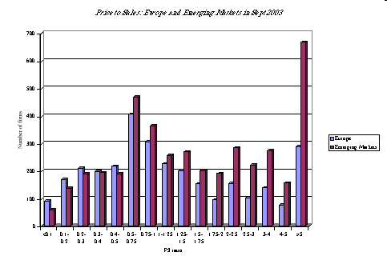
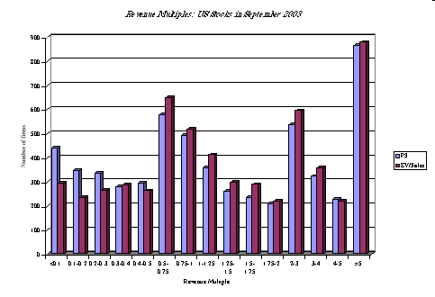
Price/Sales Ratio: US stocks
Price to Sales: Europe and Emerging Markets
Notes:
Perhaps the most skewed of all multiples….

Slide 37
Price/Sales Ratio: Determinants
The price/sales ratio of a stable growth firm can be estimated beginning with a stable growth equity valuation model:
Dividing both sides by the sales per share:
Notes:
The key determinant of the price to sales ratio is the net margin.. The other 3 determinants - payout, growth and cost of equity - are common to all equity multiples.
Current versus Predicted Margins
One of the limitations of the analysis we did in these last few pages is the focus on current margins. Stocks are priced based upon expected margins rather than current margins.
For most firms, current margins and predicted margins are highly correlated, making the analysis still relevant.
For firms where current margins have little or no correlation with expected margins, regressions of price to sales ratios against current margins (or price to book against current return on equity) will not provide much explanatory power.
In these cases, it makes more sense to
use some proxy for predicted margins
Use forward multiples

Slide 38
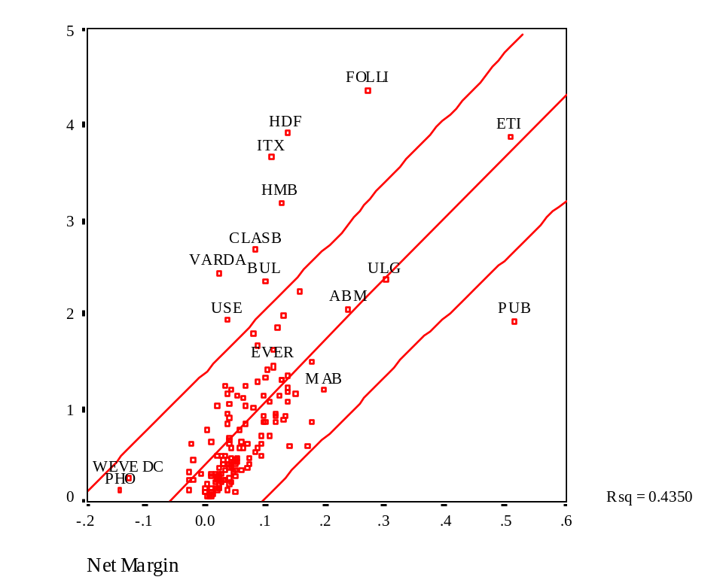
PS/Margins: European Retailers - September 2003
Regressing PS ratios against net margins,
PS = -.39 + 0.6548 (Net Margin)
R² = 43.5%
Thus, a 1% increase in the margin results in an increase of 0.6548 in the price sales ratios.
The regression also allows us to get predicted PS ratios for these firms
Notes:
Eyeballing the data.. Lower price to sales ratio firms tend to have low net margins and higher price to sales ratio firms tend to have high margins..
High R-squared….

Slide 39
PS Regression
 | US |  | Europe |  | Emerging Markets
Net Margin | 0.2100 | (35.96) | 0.202 | (50.85) | 0.061 | (27.59)
Payout Ratio | -0.0243 | (-11.73) | 0.020 | (9.25) | 0.008 | (7.91)
Growth | 0.1290 | (16.77) | 0.145 | (15.55) | 0.163 | (16.67)
R² | 0.8540 |  | 0.826 |  | 0.507
Notes:
A regression for the entire market…. Again, net margin is the dominant variable determining price to sales ratio. The R-squared of this regression is much higher than the earlier regressions using earnings and book value…
R-sq is lower in Europe and emerging markets due to other factors affecting PS ratio that are not included in the regression.

Slide 40
Choosing Between the Multiples
There are many multiples that can be potentially used to value an individual firm.
Relative valuation can be relative:
  to a sector (or comparable firms) or
  to the entire market (using the regressions)
Since there can be only one final estimate of value, there are three choices at this stage:
Use a simple average of the valuations obtained using a number of different multiples
Use a weighted average of the valuations obtained using a number of different multiples
Choose one of the multiples and base your valuation on that multiple
Notes:
When doing relative valuation, you can choose between potentially a dozen or more multiples. With each multiple, you will estimate a different value for your firm, leaving you with the unenviable task of reconciling these values.

Slide 41
Picking one Multiple
This is usually the best way to approach this issue. While a range of values can be obtained from a number of multiples, the “best estimate” value is obtained using one multiple.
Use the multiple that best fits your objective.
Thus, if you want the company to be undervalued, you pick the multiple that yields the highest value.
Use the multiple that has the highest R-squared
Use the multiple that seems to make the most sense for that sector,
in the sector when regressed against fundamentals. Thus, if you have tried PE, PBV, PS, etc. and run regressions of these multiples against fundamentals, use the multiple that works best at explaining differences across firms in that sector.
given how value is measured and created.
Notes:
This is probably the preferred approach. Pick one multiple, but which one will depend upon what you view your objective to be.
When we say a multiple that makes sense, this is open to interpretation. However, you could follow a more intuitive approach.
As a general rule of thumb, the following table provides a way of picking a multiple for a sector
Sector Multiple Used Rationale
Cyclical Manufacturing PE, Relative PE Often with normalized earnings
High Tech, High Growth PEG Big differences in growth across firms
High Growth/No Earnings PS, VS Assume future margins will be good
Heavy Infrastructure VEBITDA Firms in sector have losses in early years and reported earnings can vary depending on depreciation method
Financial Services PBV Book value often marked to market
Retailing PS If leverage is similar across firms
VS If leverage is different
Not a set of iron-clad rules, but more rules of thumb…
Normalized earnings
You can normalize earning using various methods:
Arithmetic or Geometric Averages
Trailing
Regressions
Use a proxy and measure the value as a proportion of a more stable figure.

Slide 42
Reviewing: The Four Steps to Understanding Multiples
Define the multiple
Check for consistency
Uniformly estimated
Describe the multiple
Skewed distributions and Averages
Check for bias and correct and/ or normalize
Analyze the multiple
Identify the determinants of the multiple
Nature of the relationship
Apply the multiple
Notes:
Reviews the four basic steps in relative valuation.

Slide 43




Relative Valuation Examples

